Slide 1
ONLINE LEARNING PLATFORM
h

Slide 2
REPHRASE: SQL project featured on an online learning platform by Hitanshi Upadhyay.

Slide 3
TABLE OF CONTENT:
Introduction:
Technology used:
Tables:
Tables Overview:
Describing Tables:
ER Diagram:
ER Diagram Description:
Requirements of this Project:
Conclusion:

Slide 4
Begin with an introductory section.
The online learning platform aims to provide a comprehensive solution for both students and instructors to engage in distance education. It will offer various courses across different subjects, allowing students to enroll, access course materials, submit assignments, and interact with instructors. Instructors can create courses, upload lecture videos, manage assignments, and communicate with students.

Slide 5
Technology Platform Used:
Technologies I have used:
MYSQL, FIGMA, (MS) POWERPOINT
MYSQL:
FOR CREATING DATABASE
FIGMA:
FOR DESIGNING ER DIAGRAM
POWERPOINT:
FOR CREATING PRESENTATION

Slide 6
Rephrase: Tables developed for my project.
USERS
COURSES
ENROLLMENTS
MATERIALS

Slide 7
Provide a detailed overview of all tables included.
Users: Columns: user_id (Primary Key), username, password, email, role (student/instructor)
Courses: Columns: course_id (Primary Key), title, description, instructor_id (Foreign Key referencing Users), status (published/unpublished)
Enrollments: Columns: enrollment_id (Primary Key), course_id (Foreign Key referencing Courses), student_id (Foreign Key referencing Users), enrollment_date
Materials: Columns: material_id (Primary Key), course_id (Foreign Key referencing Courses), title, type (video/assignment/resource), file_path

Slide 8
Users Table:
Field | Type | Null | Key | Default | Extra
user_id | int | No | PRI | NULL
username | varchar(50) | Yes |  | NULL
password | varchar(50) | Yes |  | NULL
email | varchar(100) | Yes |  | NULL
role | varchar(20) | Yes |  | NULL

Slide 9
Courses Table:
FIELD | Title | NULL | KEY | DEFAULT | EXTRA
Course_id | Int | NO | PRI | NULL
Title | Varchar(100) | YES |  | NULL
Description | Text | YES |  | NULL
Instruction_id | Int | YES | MUL | NULL
Status | Varchar(20) | YES |  | NULL

Slide 10
Enrollments Tables:
Field | Type | NULL | KEY | Default | extra
Enrollment_id | int | NO | PRI | NULL
Course_id | int | YES | MUL | NULL
Student_id | int | YES | MUL | NULL
enrollment_date | date | YES |  | NULL

Slide 11
Materials Table:
Field | Type | Null | KEY | DEFAULT | EXTRA
Material_id | Int | NO | PRI | NULL
Course_id | Int | YES | MUL | NULL
Title | Varchar(100) | YES |  | NULL
Type | Varchar(20) | YES |  | NULL
File_path | Varchar(255) | YES |  | NULL

Slide 12
ER-Diagram:
An entity relationship is a way of describing how different things are connected or related to each other in a system or database.
Think of it like this: in real life, you have different things or objects (which we call entities), like people, cars, books, etc. These entities often have relationships with each other. For example, a person can own a car, a book can be written by an author, and so on.
In a database or system, we represent these entities and their relationships using diagrams. We use different symbols and lines to show how they are connected.

Slide 13
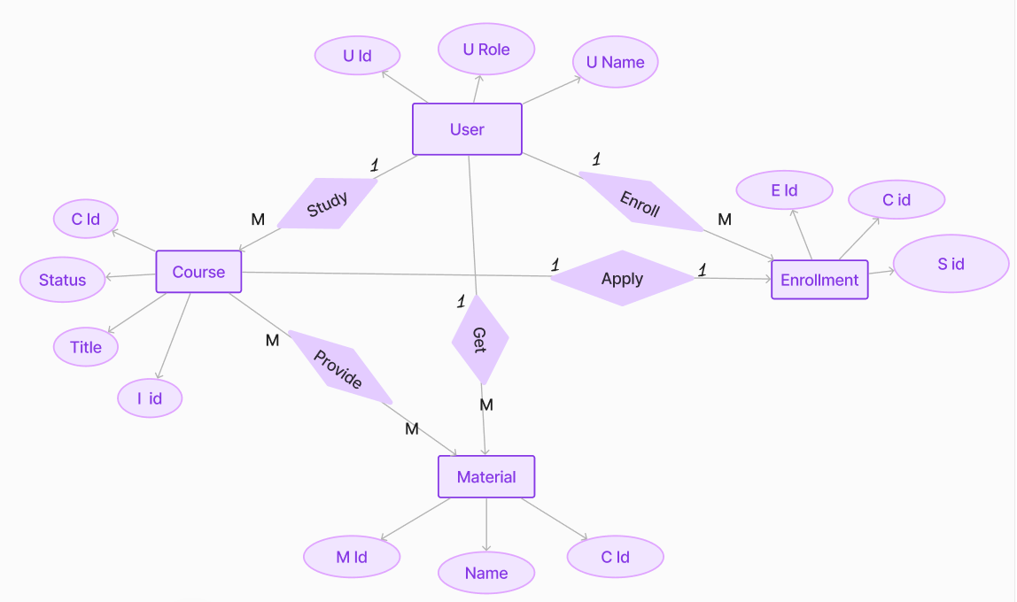
Er Diagram -
hh

Slide 14
Requirements of this Project
User Authentication and Management: Develop functionalities to securely store user information such as usernames, passwords, and email addresses. Implement role-based access control to differentiate between students and instructors.
Course Creation and Management: Enable instructors to create courses by providing functionalities to input course title, description, and status (published/unpublished). Ensure that each course is associated with the respective instructor.
Enrollment Management: Implement mechanisms for students to enroll in courses. Utilize foreign keys tonal resources. Utilize foreign keys to associate materials with their corresponding courses.
Material Management: Create a system for uploading and managing course materials such as lecture videos, assignments, and additional resources. Utilize foreign keys to associate materials with their corresponding courses.
Data Integrity and Consistency: Ensure that database constraints are in place to maintain data integrity. Implement primary and foreign keys to establish relationships between tables and enforce referential integrity.

Slide 15
CONCLUSION:
In conclusion, the online learning platform presented in this project serves as a versatile tool catering to the needs of both students and instructors in the realm of distance education. By offering a wide array of courses spanning various subjects , the platform facilitates seamless enrolment, access to course materials, assignments submissions, and interactive communication between students and instructors. Furthermore, instructors are empowered with features enabling them to effortlessly create courses, upload lecture videos, manage assignments, and maintain effective communications channels with their students. This project underscores the significance of technological solutions in enhancing the accessibility and efficacy of education in todays digital age.

Slide 16
I would like to extend my heartfelt gratitude to each and every one of you for taking the time to attend my project presentation today. Your presence, attention, and insightful questions mean a great deal to me. THANK YOU….

